Slide 1

HTML

Slide 2
What is HTML?
HTML stands for Hyper Text Markup Language
HTML is a markup language
A markup language is a set of markup tags
The tags describe document content
HTML documents contain HTML tags and plain text
HTML documents are also called web pages

Slide 3

Web Browsers
The purpose of a web browser (such as Google Chrome, Internet Explorer, Firefox, Safari) is to read HTML documents and display them as web pages.
The browser does not display the HTML tags, but uses the tags to determine how the content of the HTML page is to be presented/displayed to the user:

Slide 4
HTML Tags
HTML markup tags are usually called HTML tags:
HTML tags are keywords (tag names) surrounded by angle brackets like <html>
HTML tags normally come in pairs like <b> and </b>
The first tag in a pair is the start tag, the second tag is the end tag
The end tag is written like the start tag, with a forward slash before the tag name
Start and end tags are also called opening tags and closing tags
Example: <tagname>content</tagname>

Slide 5
Closing tags
The </body> and </html> put a close to their respective elements.
Not all tags have closing tags like this . Some tags, which do not wrap around content will close themselves. The line-break tag for example, looks like this : <br> A line break doesn’t hold any content so the tag just sits by itself.
You might come across “self-closing” tags, whereby a br tag, for example, will look like <br /> instead of simply <br>. This is a remnant of XHTML, a form of HTML based on another markup language called XML. HTML5 will be happy with either format.
All tags with content between them should be closed, in the format of opening tag → content → closing tag. It isn’t, strictly speaking, always a requirement, but it’s good practice.

Slide 6
What are Attributes and Elements?
Attributes
Tags can also have attributes, which are extra bits of information. Attributes appear inside the opening tag and their values sit inside quotation marks. They look something like <tag attribute="value">Sample text</tag>. We will come across tags with attributes later.
Elements
Tags tend not to do much more than mark the beginning and end of an element. Elements are the bits that make up web pages. While <title> and </title> are tags, <title>The Silmarillion</title> is a title element.

Slide 7
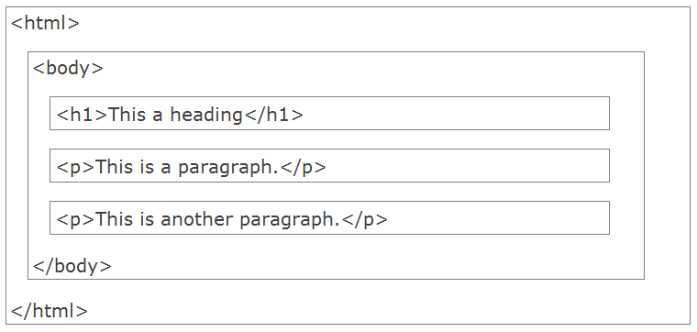
HTML Page Structure

Slide 8
HTML Versions
Version | Year
HTML | 1991
HTML+ | 1993
HTML 2.0 | 1995
HTML 3.2 | 1997
HTML 4.01 | 1999
XHTML | 2000
HTML5 | 2012

Slide 9
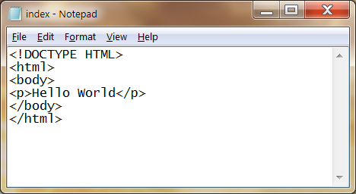
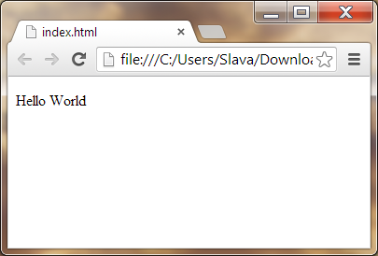
Editing HTML with Notepad
Start Notepad
Edit Your HTML with Notepad
Step 3: Save Your HTML
Select Save as.. in Notepad's file menu.
Type “filename.html” (including double quotes)
Open the HTML file in Your Browser

Slide 10
The <!DOCTYPE> Declaration
The <!DOCTYPE> declaration must be the very first thing in your HTML document, before the <html> tag.
The <!DOCTYPE> declaration is not an HTML tag; it is an instruction to the web browser about what version of HTML the page is written in.
Always add the <!DOCTYPE> declaration to your HTML documents, so that the browser knows what type of document to expect.
Common Declarations:
HTML5
<!DOCTYPE html>
HTML 4.01
<!DOCTYPE HTML PUBLIC "-//W3C//DTD HTML 4.01 Transitional//EN" "http://www.w3.org/TR/html4/loose.dtd">
XHTML 1.0
<!DOCTYPE html PUBLIC "-//W3C//DTD XHTML 1.0 Transitional//EN" "http://www.w3.org/TR/xhtml1/DTD/xhtml1-transitional.dtd">

Slide 11
<head> and <body>
<head>
The head element (that which starts with the <head> opening tag and ends with the </head> closing tag) appears before the body element and contains information about the page. The information in the head element does not appear in the browser window.
<body>
Contains the document itself.

Slide 12
<title>
The <title> tag must be placed inside the <head> element:
<!DOCTYPE html>
<html>
<head>
<title>My first web page</title>
</head>
<body>
This is my first web page
</body>
</html>
If you look at this document in the browser (save and reload as before), you will see that “My first web page” will appear on a tab or the title bar of the window . The text that you put in between the title tags has become the title of the document. If you were to add this page to your “favorites” (or “bookmarks”, depending on your browser), you would see that the title is also used there.

Slide 13
HTML Headings
Headings are defined with the <h1> to <h6> tags.
<h1> defines the most important heading. <h6> defines the least important heading.
Use HTML headings for headings only. Don't use headings to make text BIG or bold.
Search engines use your headings to index the structure and content of your web pages.
Since users may skim your pages by its headings, it is important to use headings to show the document structure.
H1 headings should be used as main headings, followed by H2 headings, then the less important H3 headings, and so on.

Slide 14
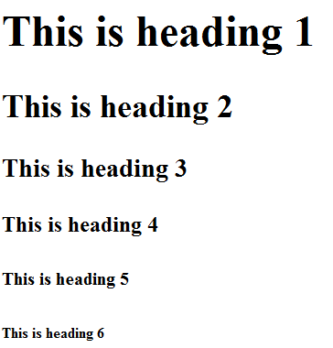
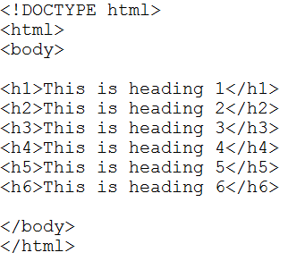
HTML Headings

Slide 15
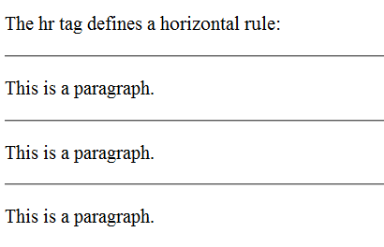
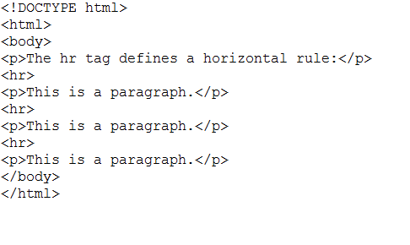
HTML Lines
The <hr> tag creates a horizontal line in an HTML page.
The hr element can be used to separate content:

Slide 16
HTML Comments
Comments can be inserted into the HTML code to make it more readable and understandable. Comments are ignored by the browser and are not displayed.
Comments are written like this:
<!-- This is a comment -->

Slide 17
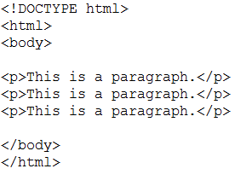
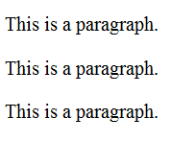
HTML Paragraphs
HTML documents are divided into paragraphs.
Paragraphs are defined with the <p> tag:
Most browsers will display HTML correctly even if you forget the end tag. However sometimes forgetting the end tag can produce unexpected results or errors. Future version of HTML will not allow you to skip end tags.

Slide 18
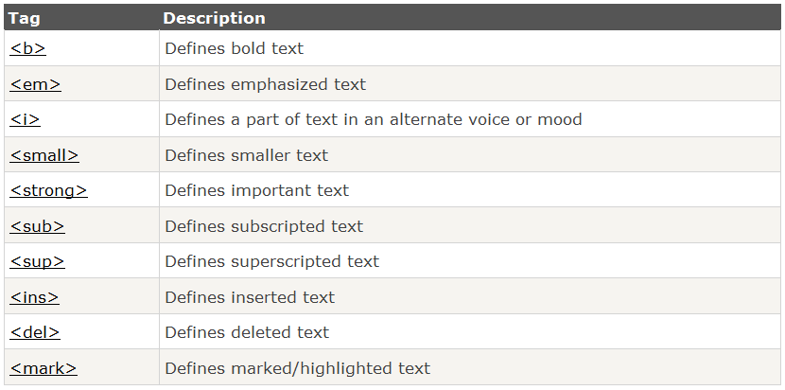
HTML Text Formatting Tags

Slide 19
<b> &<i> vs <strong> & <em>
HTML uses tags like <b> and <i> for formatting output, like bold or italic text. Often <strong> renders as <b>, and <em> renders as <i>.
For example <b> and <strong> :
<b> is a style - we know what "bold" is supposed to look like.
<strong> however is an indication of how something should be understood. "Strong" could (and often does) mean "bold" in a browser, but it could also mean a lower tone for a speaking program like Jaws (for blind people). And strong on a Palm Pilot may be an underline (since you can't bold a bold).
HTML was never meant to be about styles. <strong> is semantic - it describes the text it surrounds ("this text should be stronger than the rest of the text you've displayed") as opposed to describing how the text it surrounds should be displayed ("this text should be bold").

Slide 20
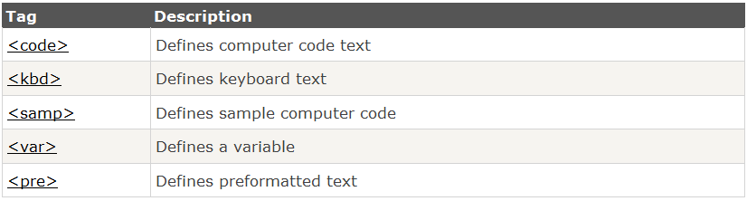
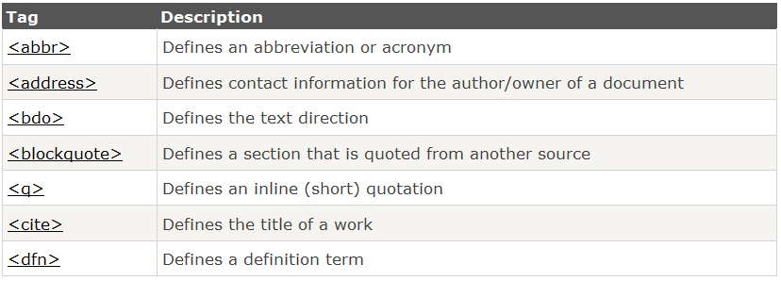
More Tags
HTML "Computer Output" Tags
HTML Citations, Quotations, and Definition Tags

Slide 21
HTML Hyperlinks
The HTML <a> tag defines a hyperlink.
A hyperlink (or link) is a word, group of words, or image that you can click on to jump to another document.
The most important attribute of the <a> element is the href attribute, which indicates the link's destination.
Syntax:
<a href="http://www.dit.ie/"> Visit DIT </a>
The target Attribute. The target attribute specifies where to open the linked document. The example below will open the linked document in a new browser window or a new tab:
<a href="http://www.dit.ie/" target="_blank"> Open DIT in a new tab </a>

Slide 22
HTML Images
In HTML, images are defined with the <img> tag.
The <img> tag is empty, which means that it contains attributes only, and has no closing tag.
To display an image on a page, you need to use the src attribute. Src stands for "source". The value of the src attribute is the URL of the image you want to display.
Syntax:
<img src="url" alt="some_text">

Slide 23

HTML Tables
Tables are defined with the <table> tag.
A table is divided into rows (with the <tr> tag), and each row is divided into data cells (with the <td> tag). td stands for "table data," and holds the content of a data cell. A <td> tag can contain text, links, images, lists, forms, other tables, etc.
<table border="1"> <tr> <td>row 1, cell 1</td> <td>row 1, cell 2</td> </tr> <tr> <td>row 2, cell 1</td> <td>row 2, cell 2</td> </tr> </table>

Slide 24
HTML Lists
Unordered Lists
An unordered list starts with the <ul> tag. Each list item starts with the <li> tag.
The list items are marked with bullets (typically small black circles).
<ul> <li>Coffee</li> <li>Milk</li> </ul>
Ordered Lists
An ordered list starts with the <ol> tag. Each list item starts with the <li> tag.
The list items are marked with numbers.
<ol> <li>Coffee</li> <li>Milk</li> </ol>
Coffee
Milk
Coffee
Milk

Slide 25
Description Lists
A description list is a list of terms/names, with a description of each term/name.
The <dl> tag defines a description list.
The <dl> tag is used in conjunction with <dt> (defines terms/names) and <dd> (describes each term/name):
<dl> <dt>Coffee</dt> <dd>- black hot drink</dd> <dt>Milk</dt> <dd>- white cold drink</dd> </dl>
Coffee
- black hot drink
Milk
- white cold drink

